Slide 1

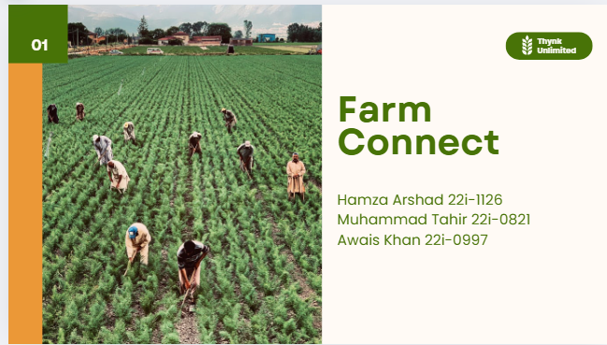

Slide 2
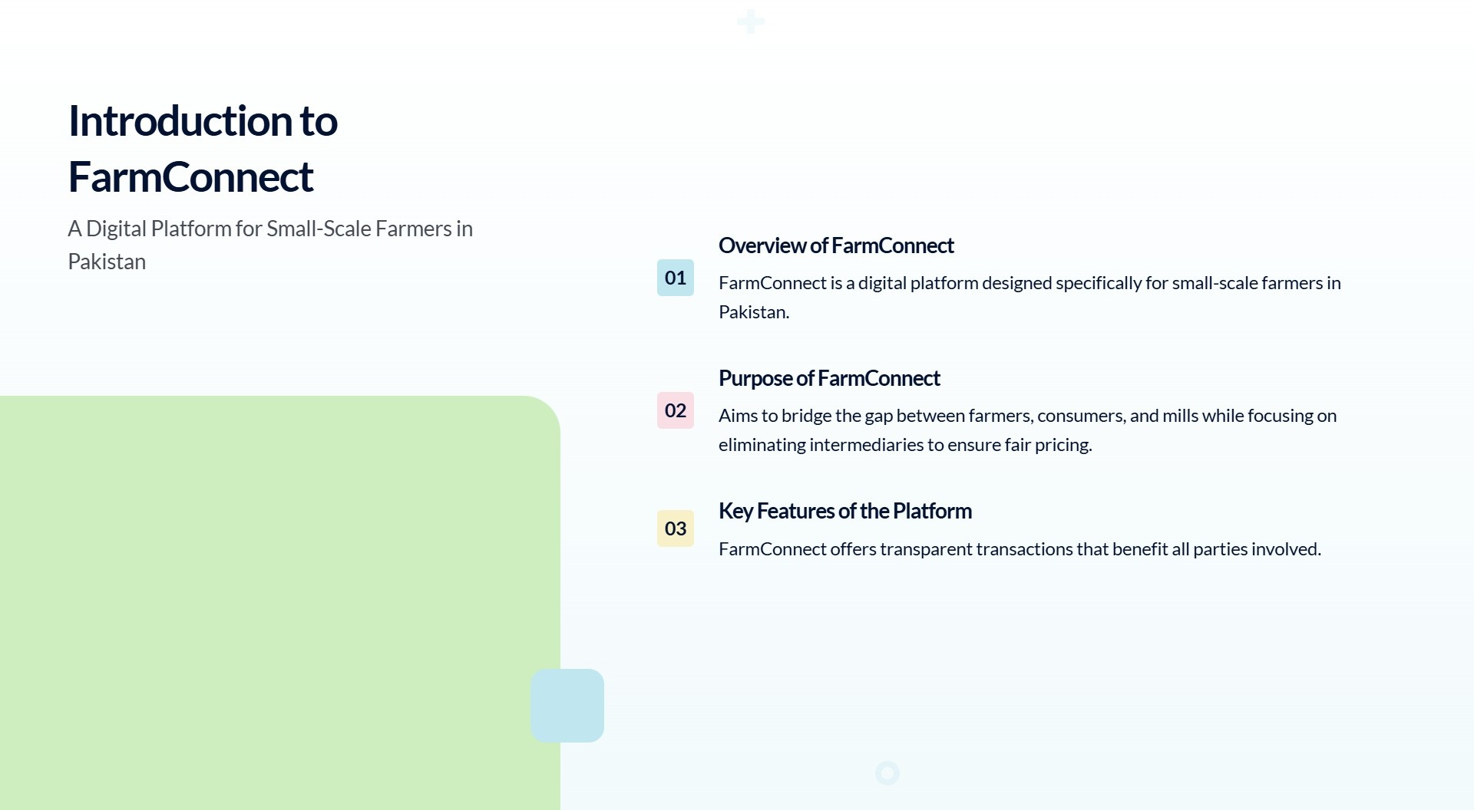


Slide 3
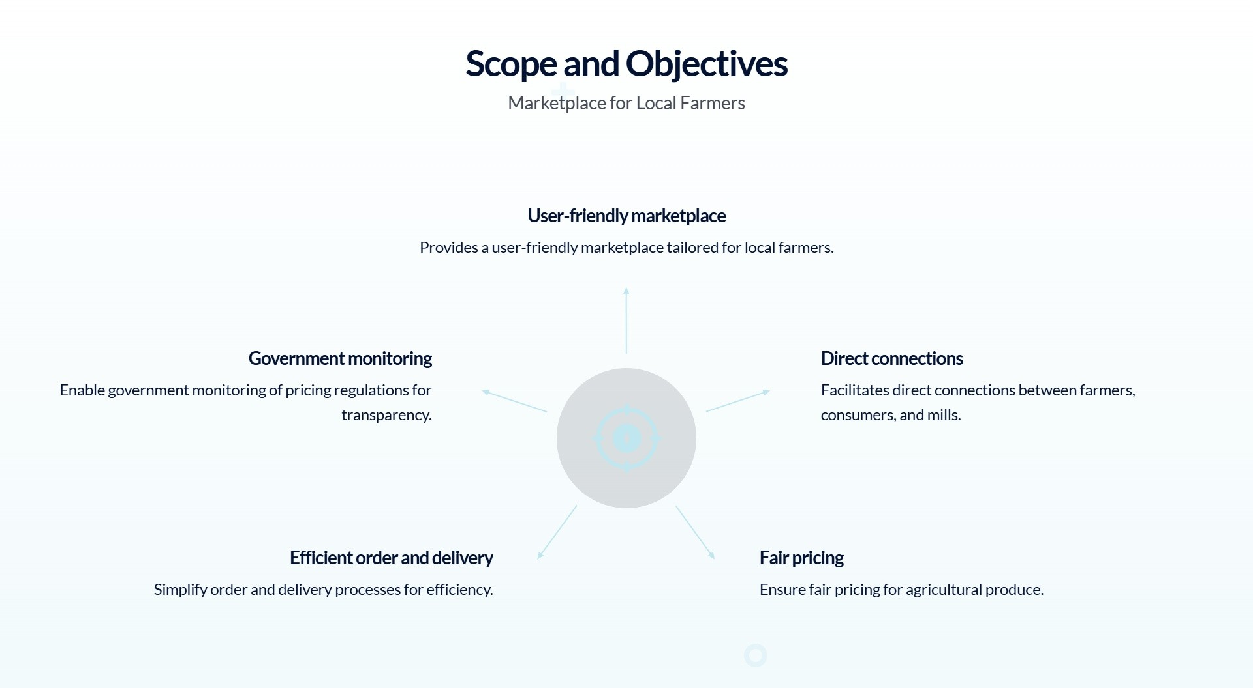

Slide 4
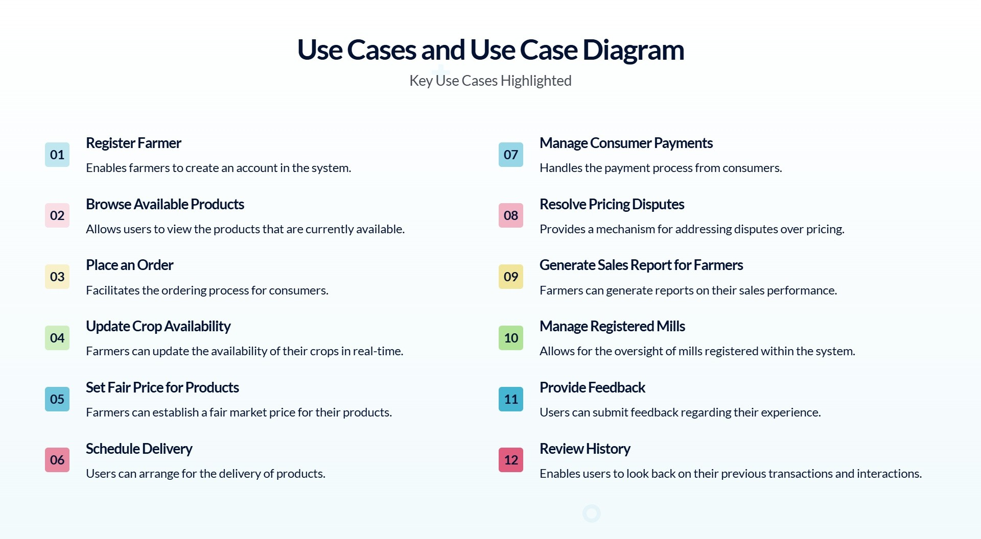

Slide 5
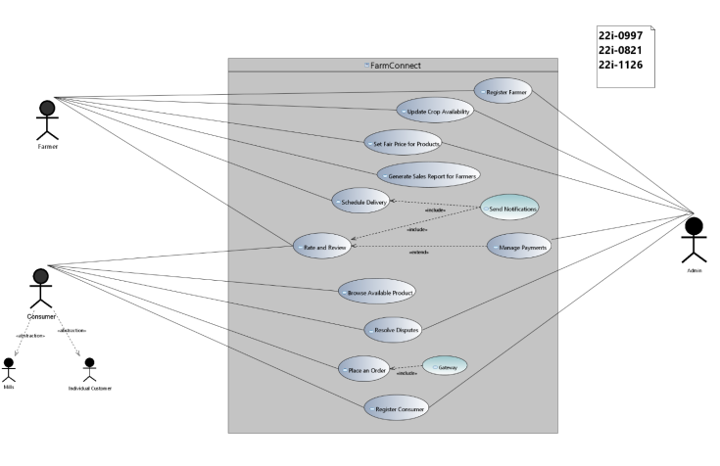
Use Case Diagram

Slide 6
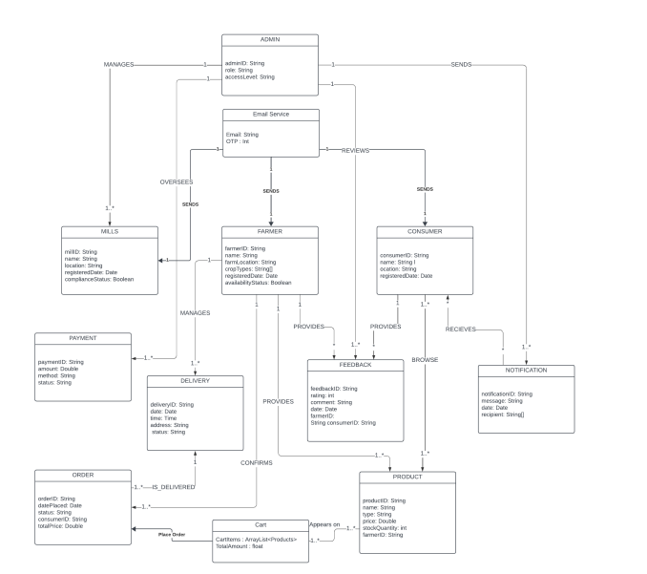
DOMAIN MODEL

Slide 7
SEQUENCE DIAGRAMS

Slide 8
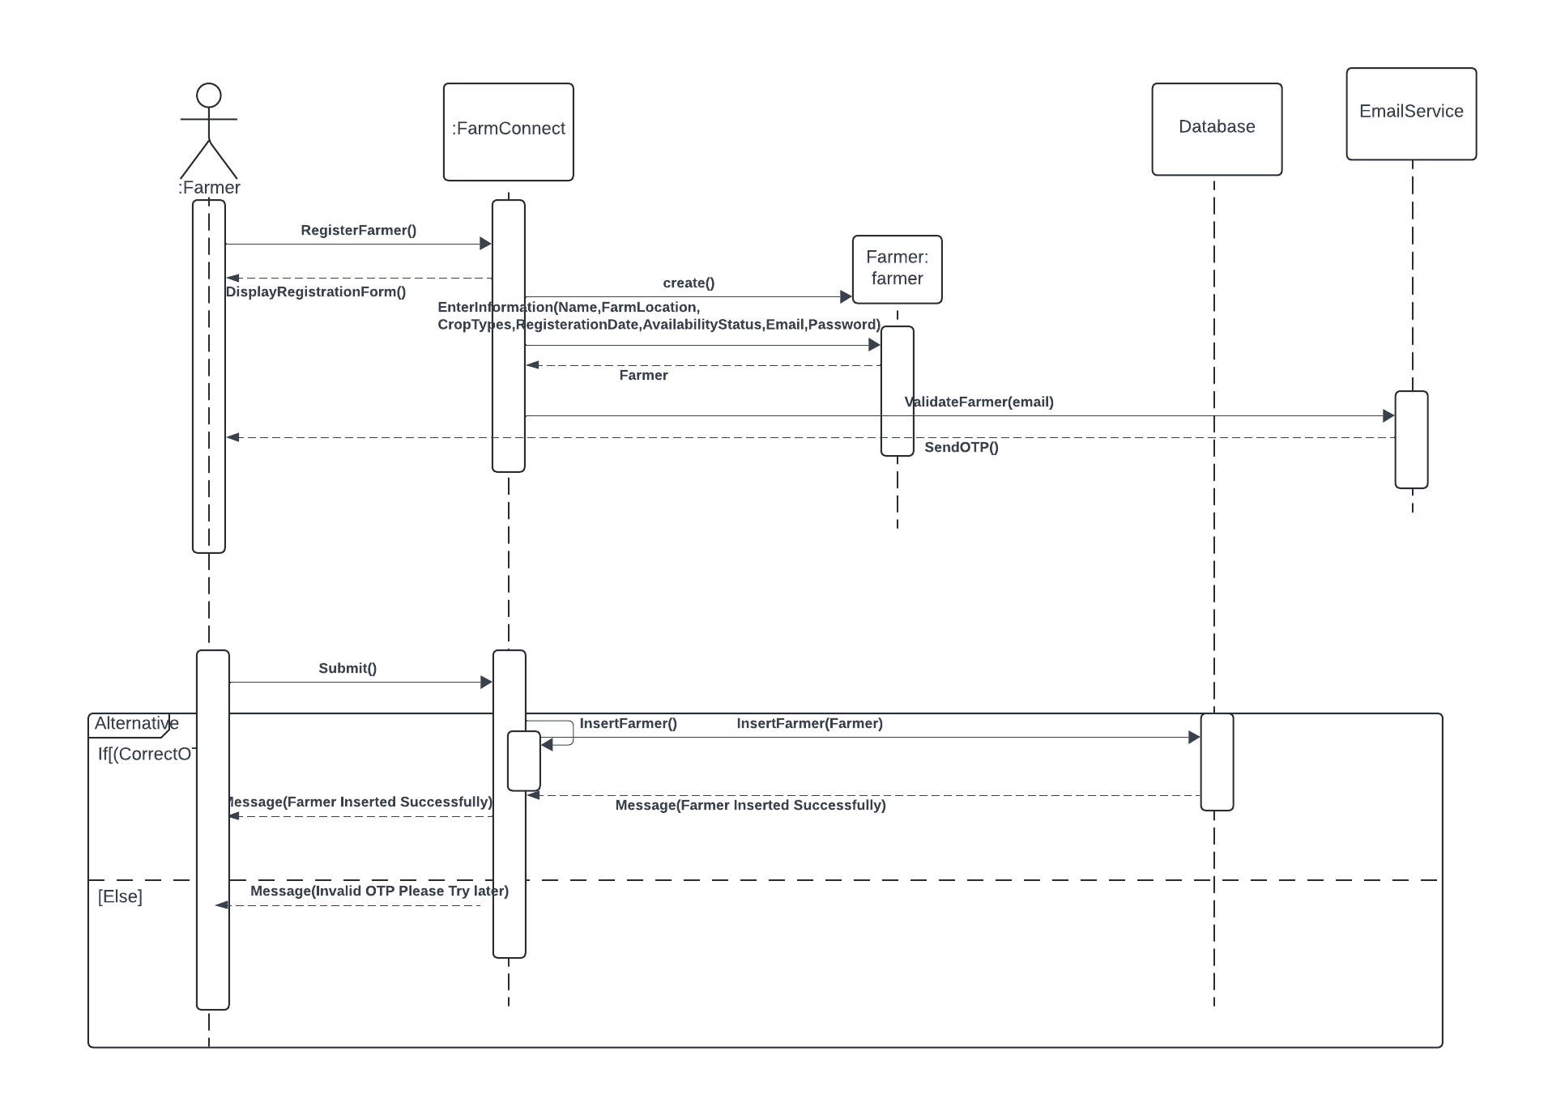
Register Farmer

Slide 9
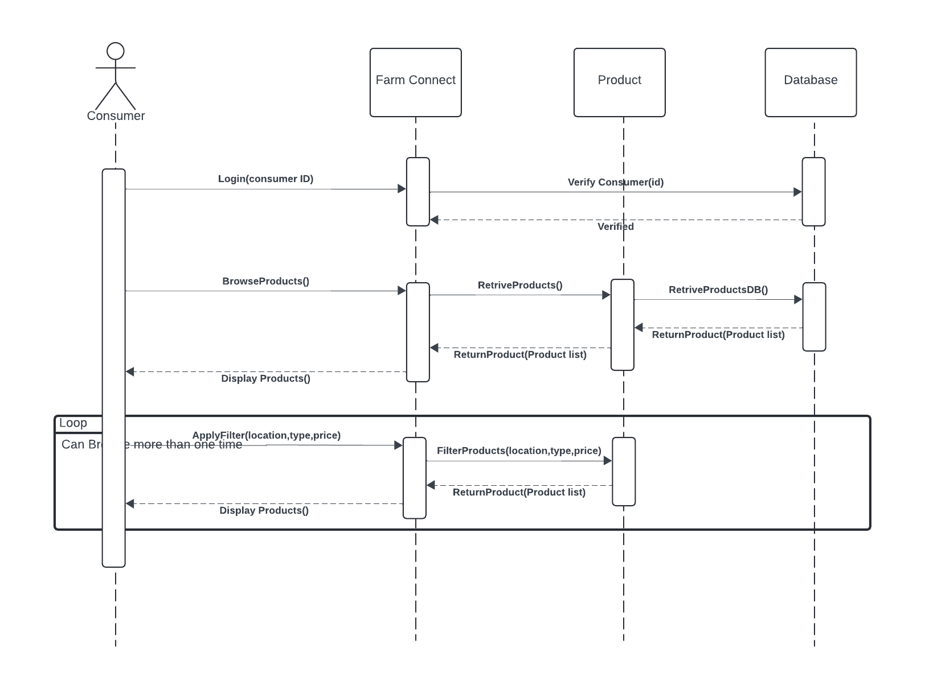
Browse AvaBrowse Available Products la\l Products

Slide 10
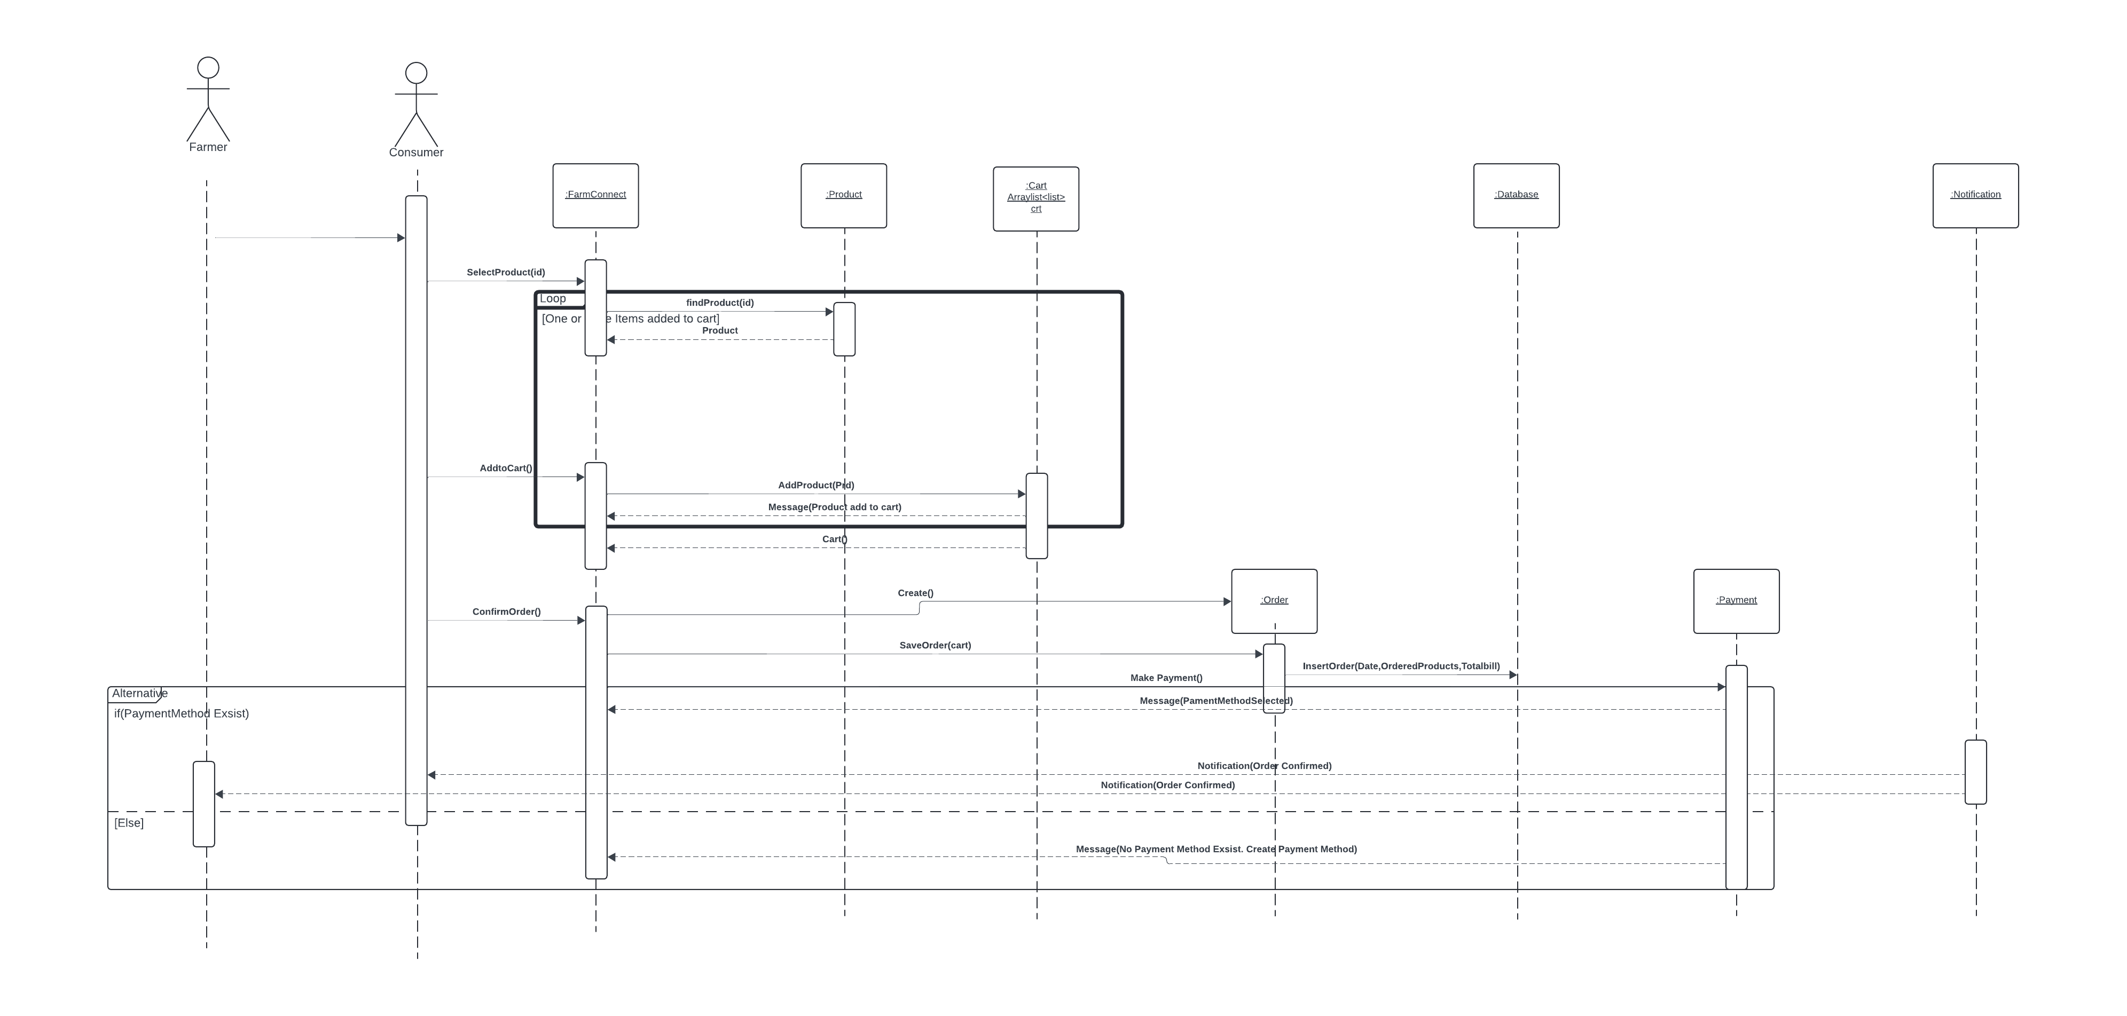
PlaPlace an Order ce an Order

Slide 11
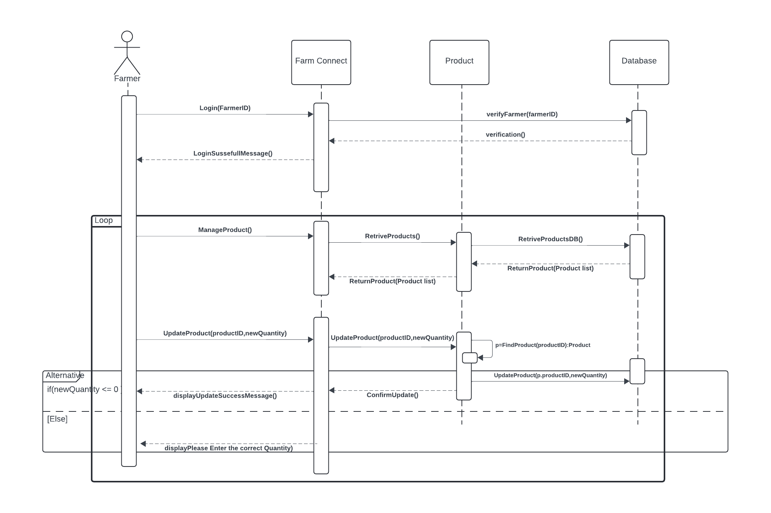
UpdaUpdate Crop Availability e Crop Availability

Slide 12
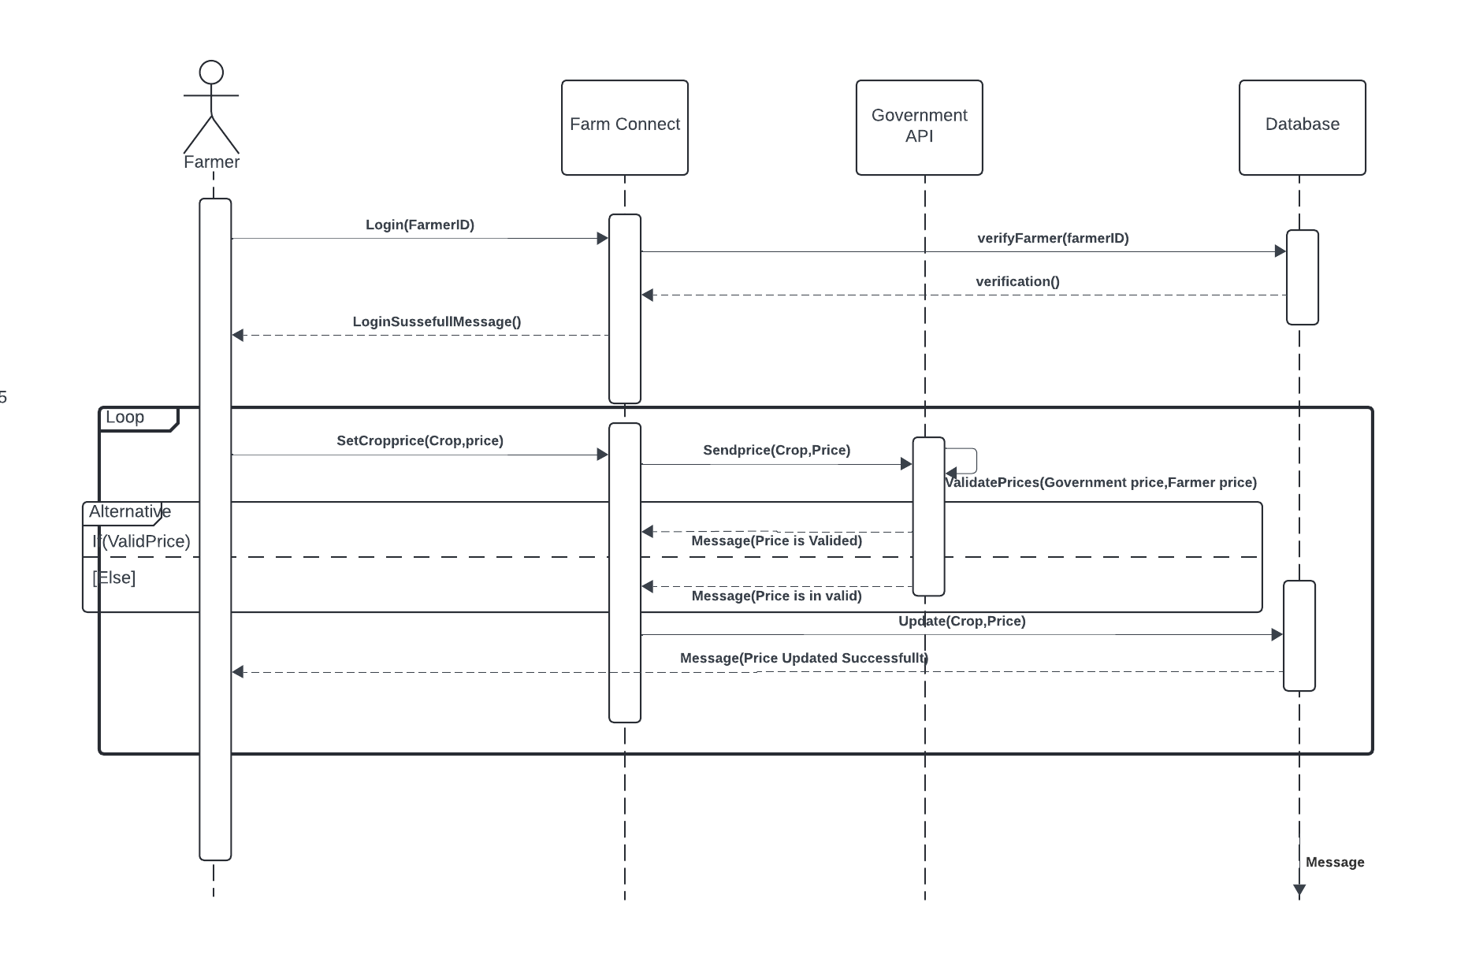
Set Set Fair Price for Products Fair Price for Products

Slide 13
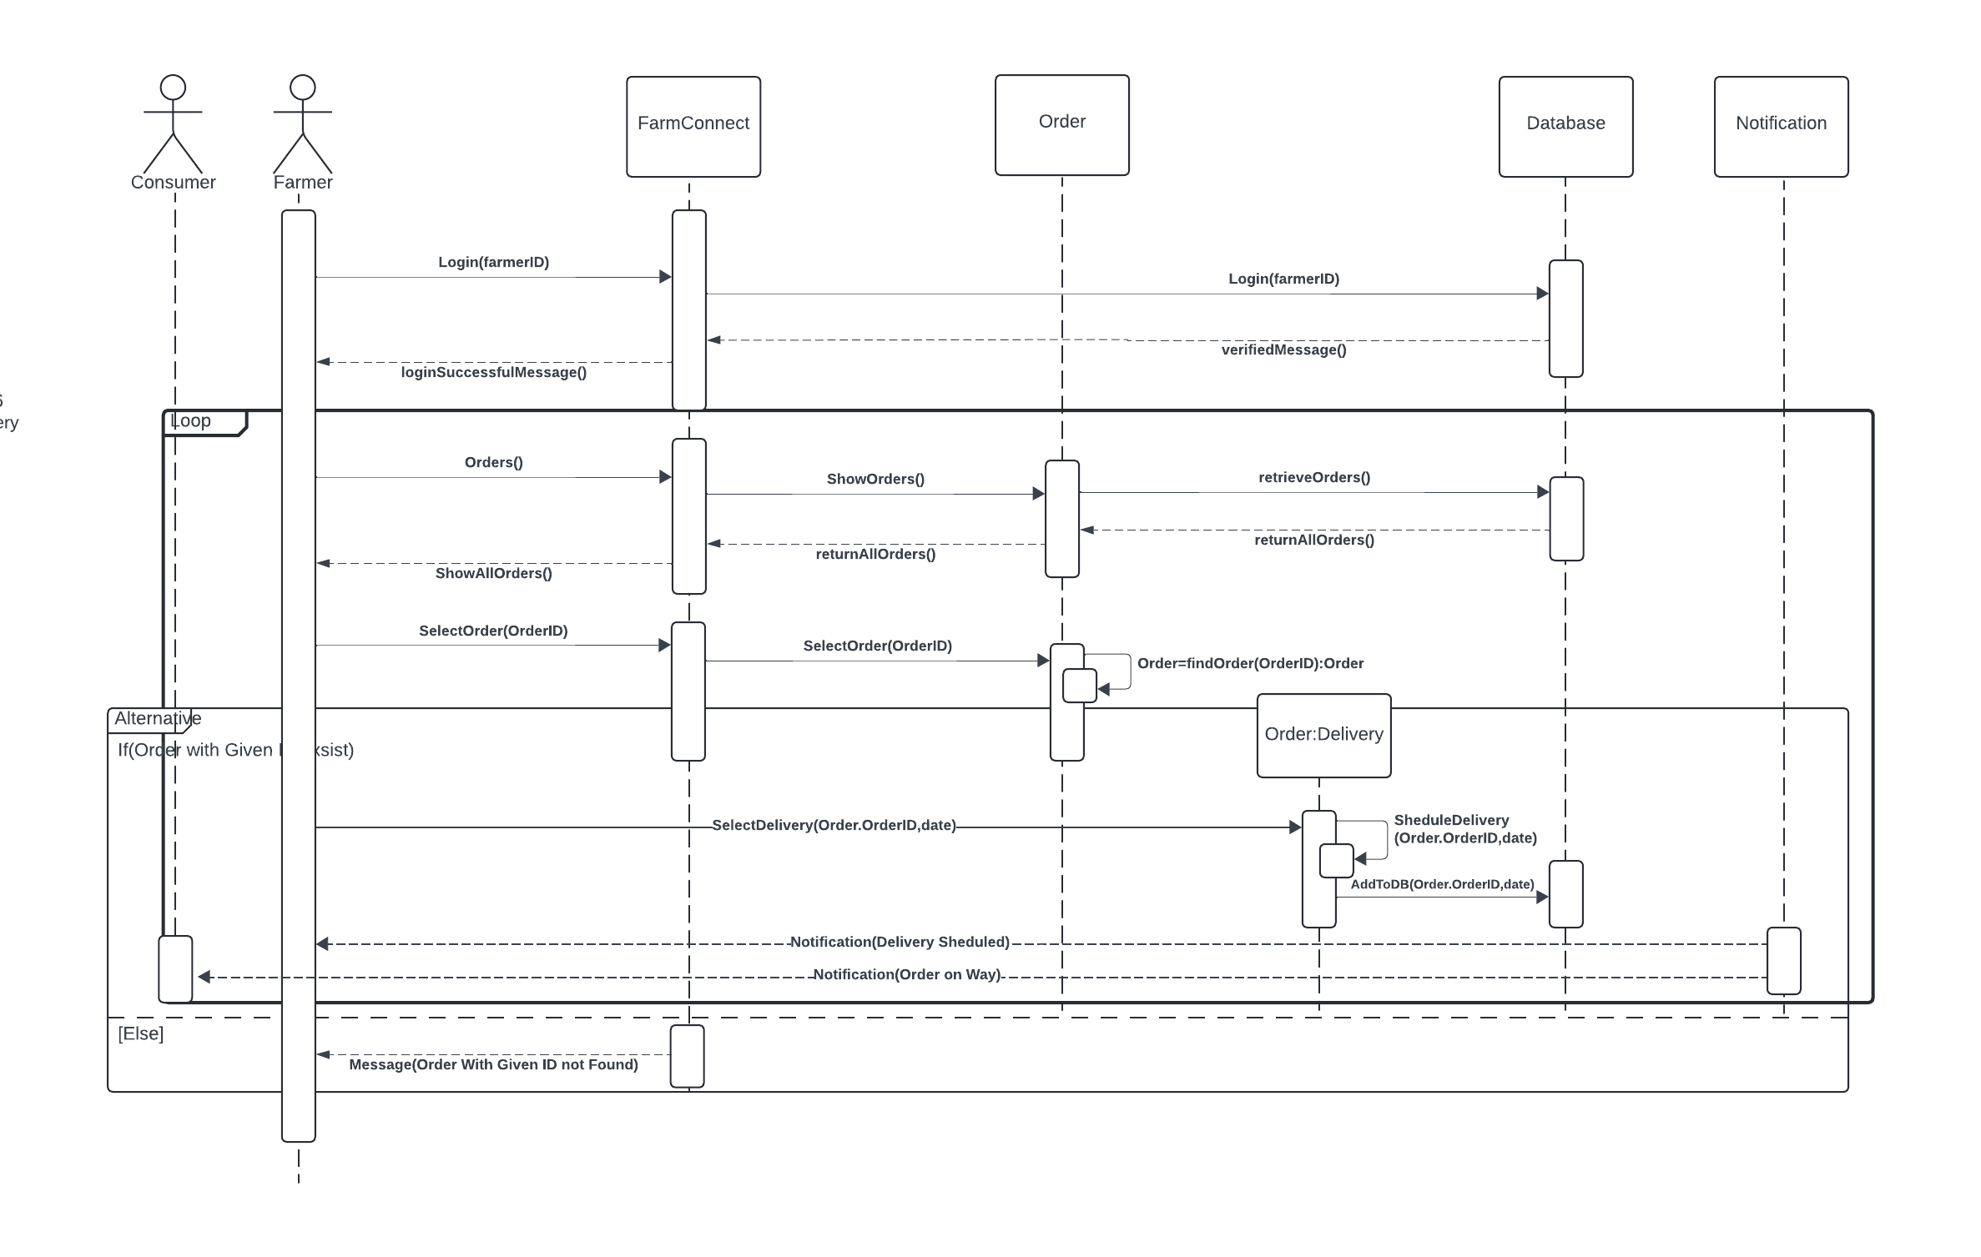
SchSchedule Delivery dule Delivery

Slide 14
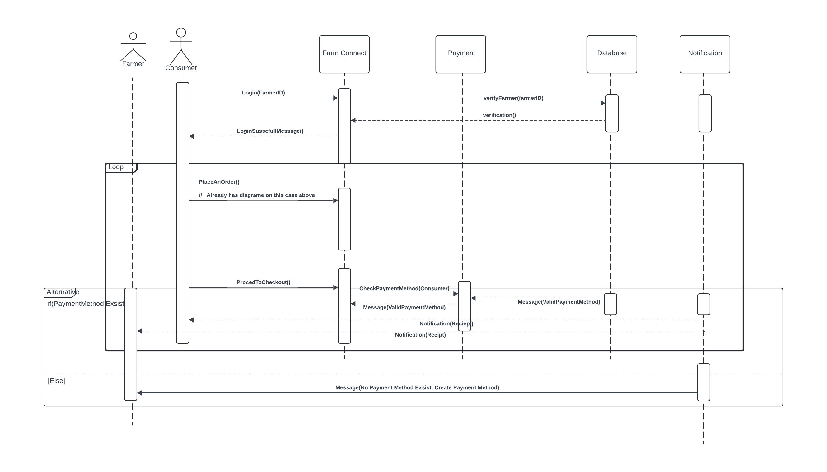
Set FaManage Consumer Payments r Price for Products

Slide 15
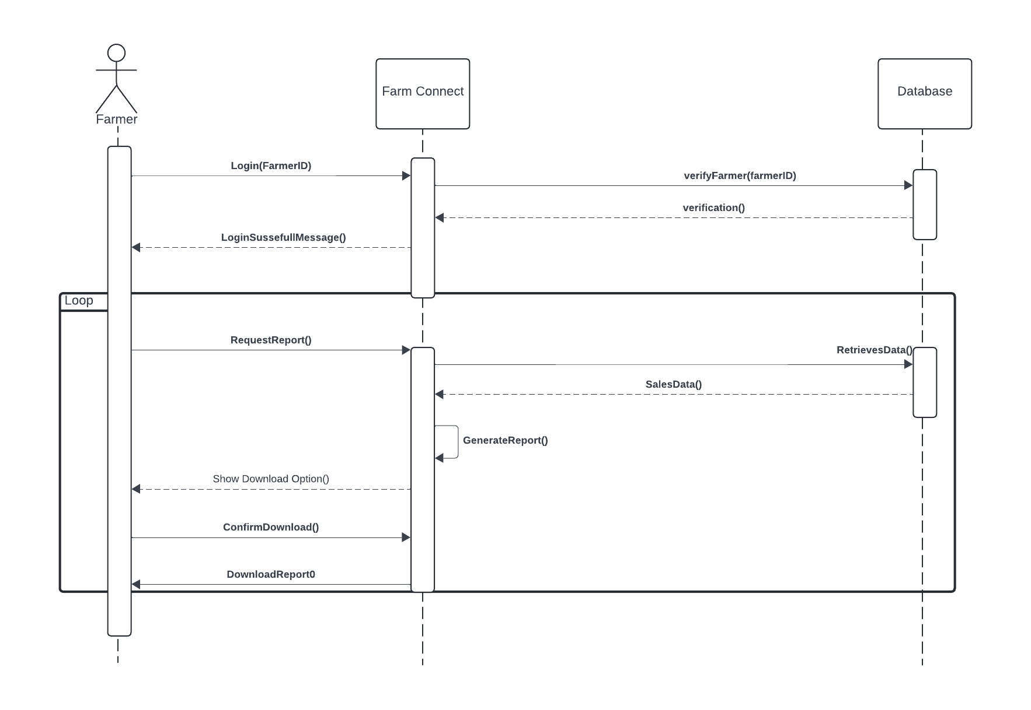
Resolve PriGenerate Sales Report for Farmers g Disputes

Slide 16
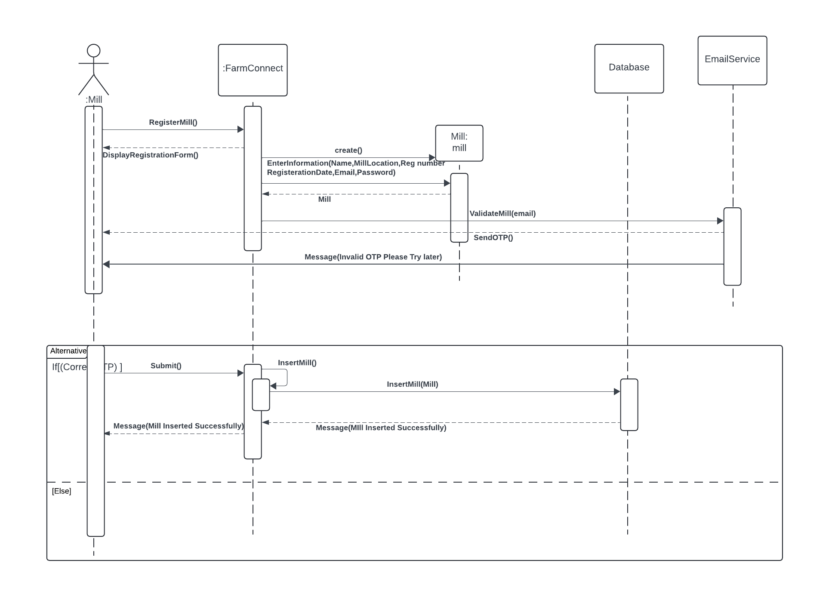
Ge Manage Registered Mills nersReport Farmers

Slide 17
Manage RegisterProvide Feedback d Mills

Slide 18
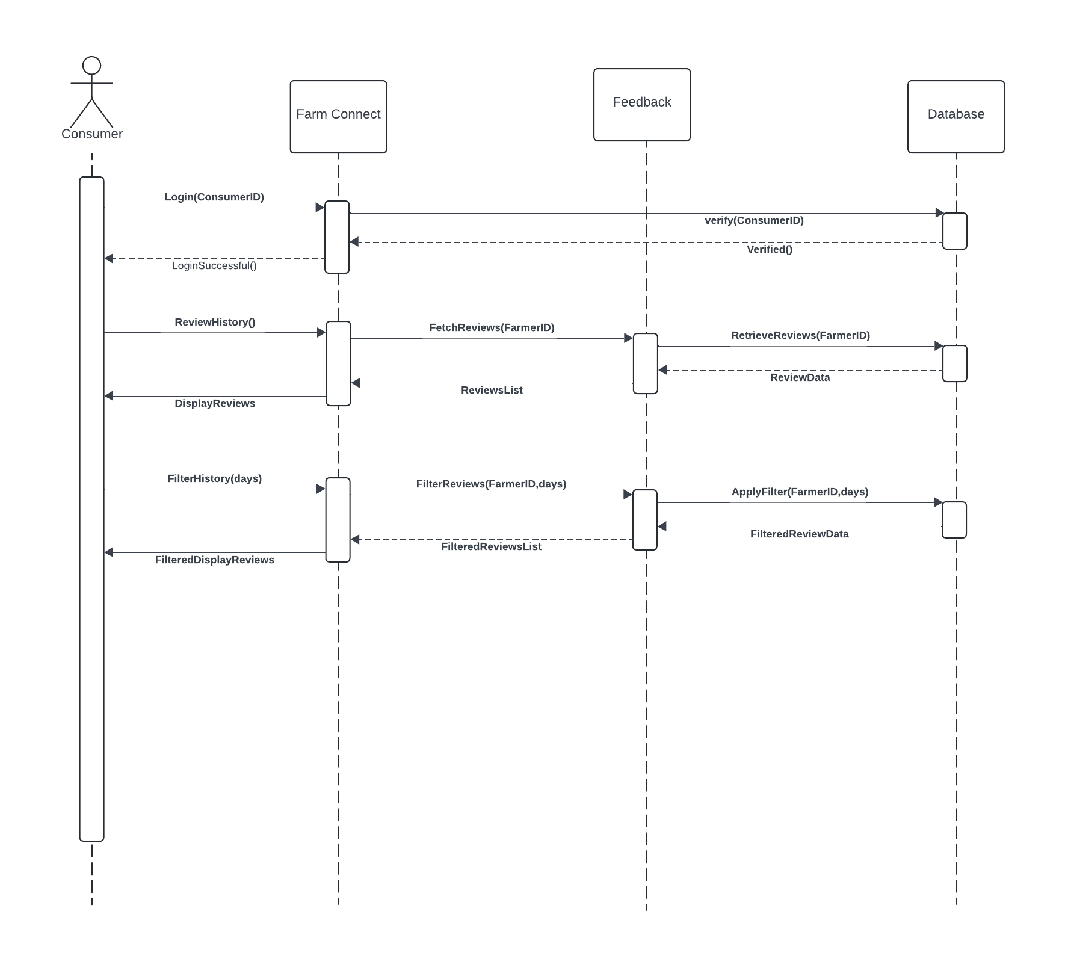
Provide Feed Review History ck

Slide 19
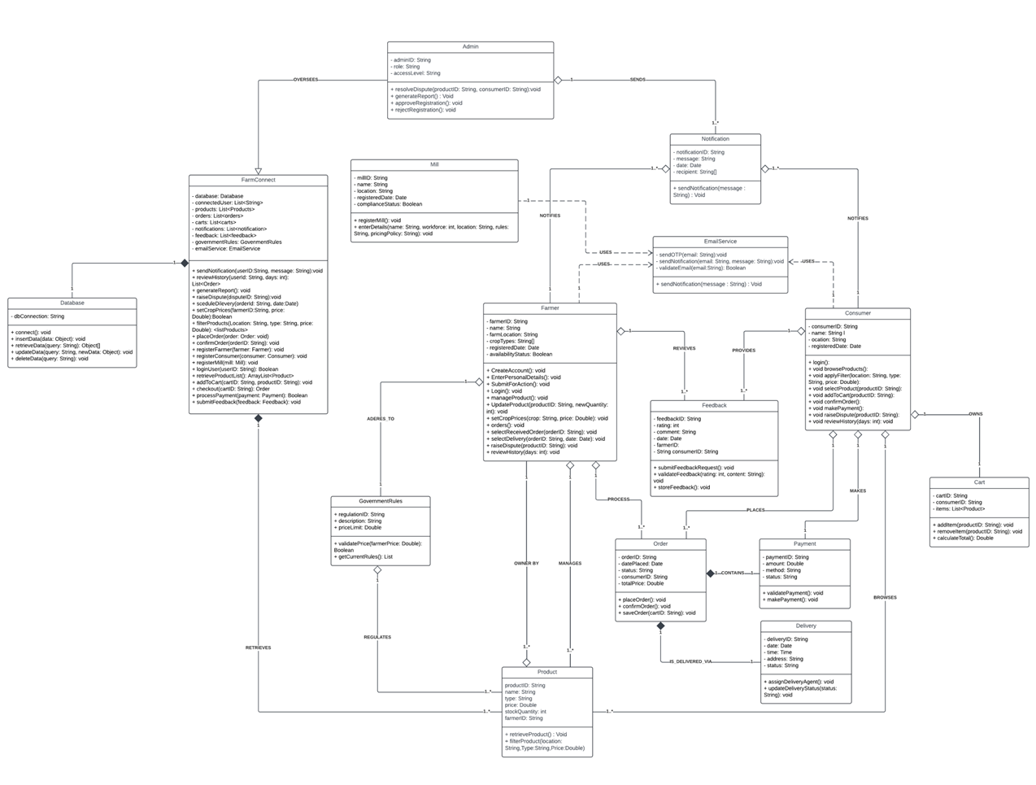
Class Diagram

Slide 20
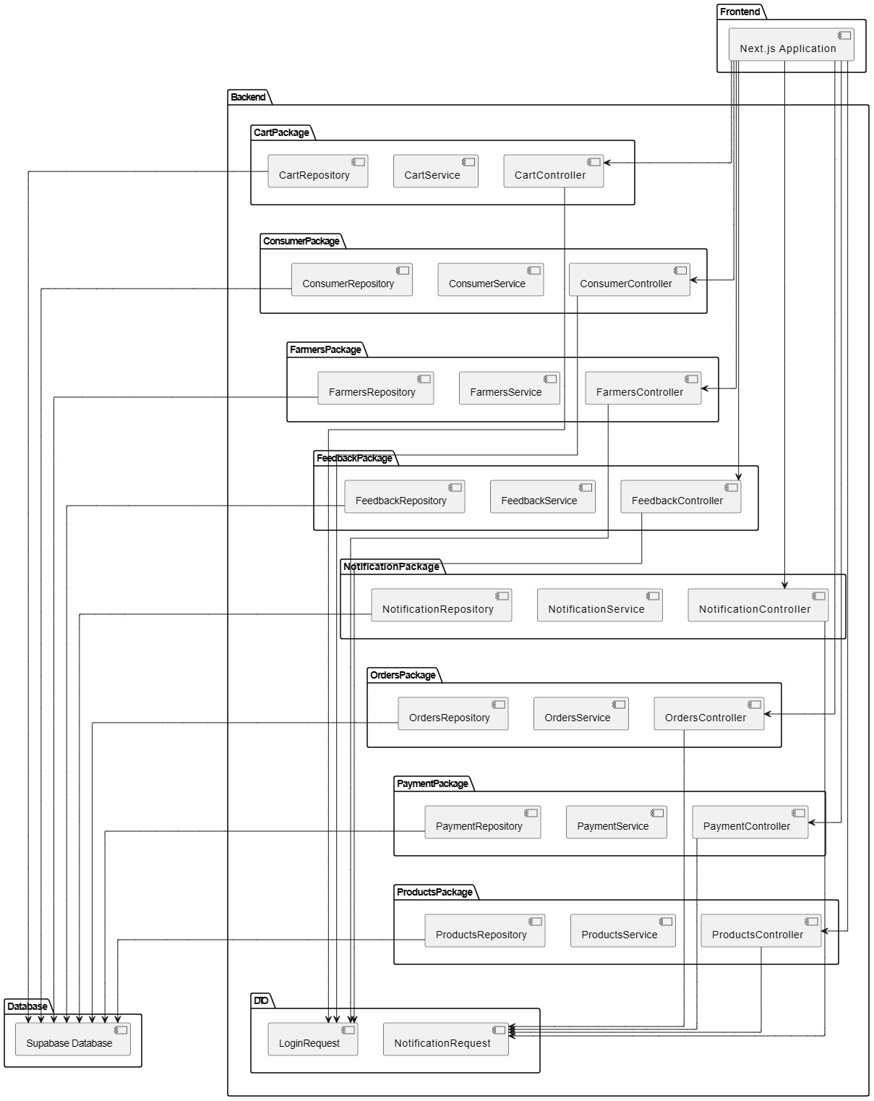
Component Diagram

Slide 21
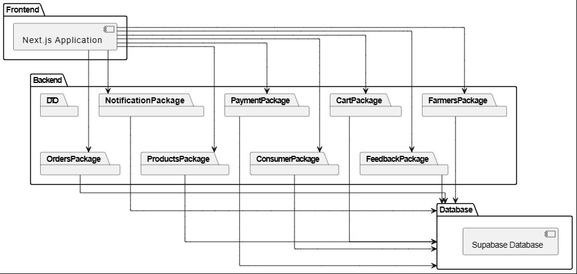
Package Diagram

Slide 22
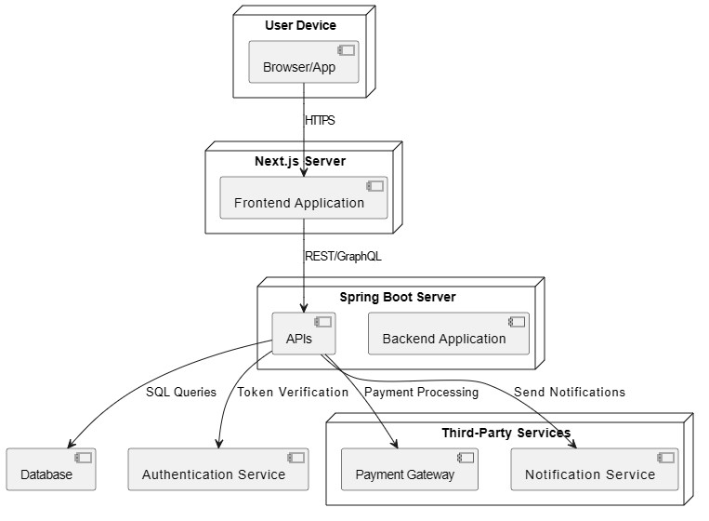
Deployment Diagram

Slide 23
DESIGN PATTERNS
GRASP Patterns
Information Expert: Farmer, Consumer, Admin
Controller: For each Use Case
Creator: Farmer
High Cohesion: Order, Transaction
Low Coupling: Payment Gateway, Delivery Service
GOF Patterns
Singleton: Database Handler
Factory: User Factory
Strategy: Pricing Strategy
Adapter: External Payment Adapter

Slide 24
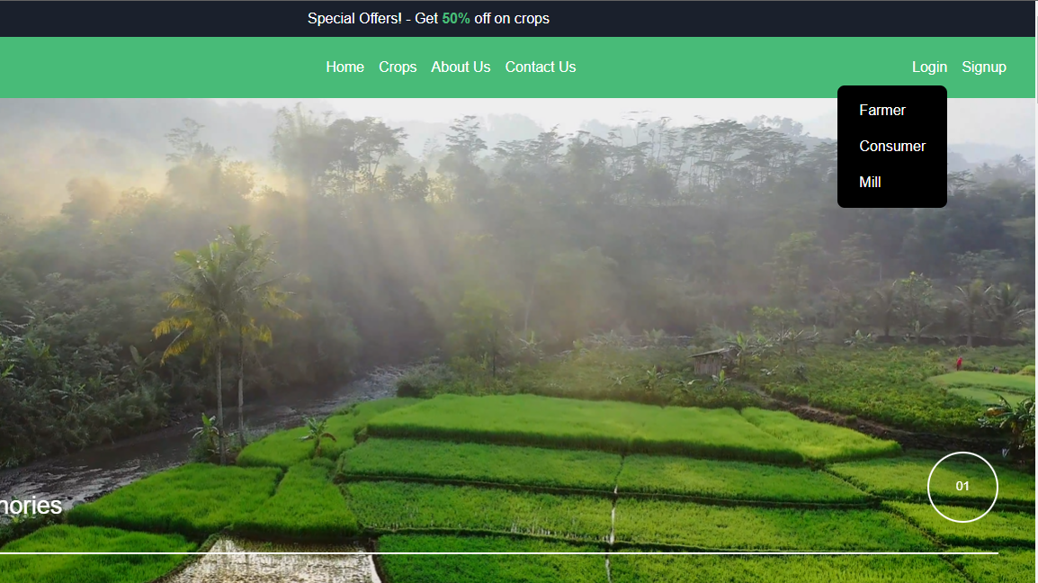

Slide 25
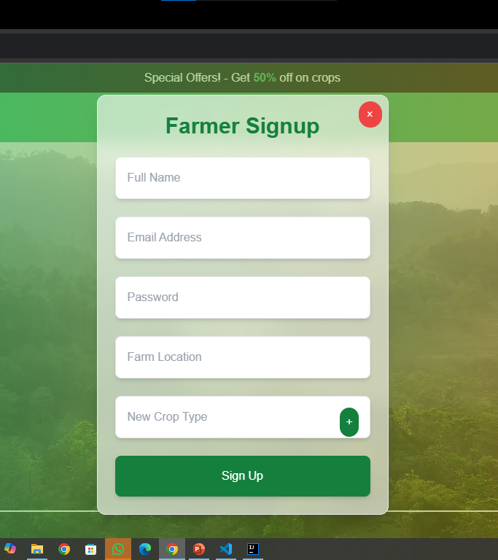
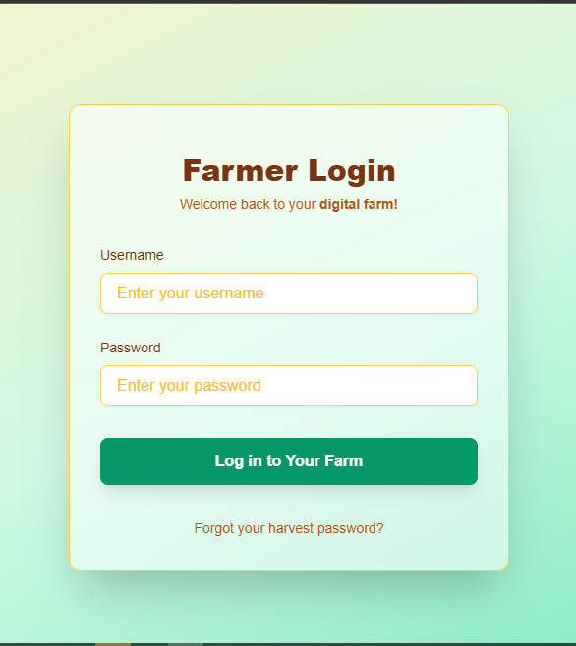

Slide 26
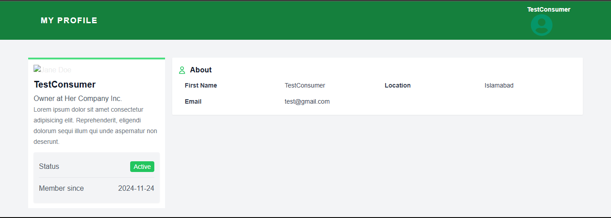

Slide 27
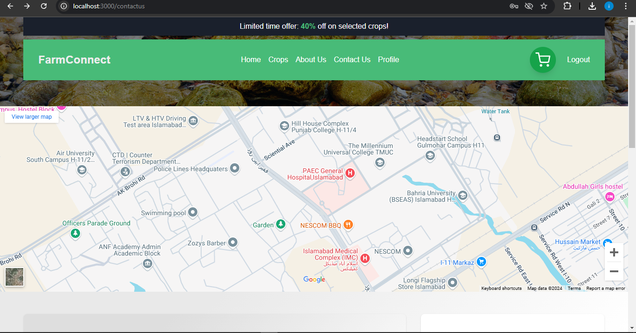

Slide 28
BUSINESS OBJECTIVES
Promote fair pricing and eliminate exploitation by intermediaries.
Provide a sustainable marketplace for small-scale farmers.
Encourage local, fresh produce consumption among urban consumers

Slide 29
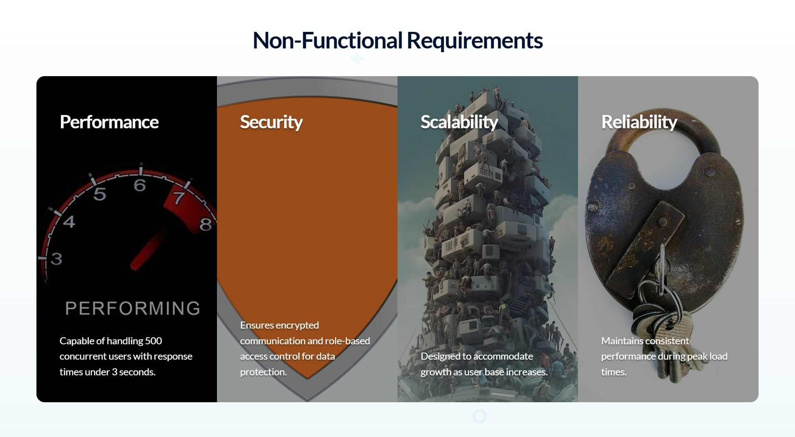

Slide 30
